Slide 1
Inventory Maintenance

Slide 2
Team Members Trilochan Reddy Sama Thrinadh Chowdary Gutta Sasank Srinivas Nadendla Sravani Jakkula

Slide 3
Inventory Maintenance
Our project is to maintain inventory for the ACS department at our university.
Inventory Maintenance is all about managing the information of a particular asset.
Information includes asset type and model, owner of the asset, the assigned person at the moment, due date, asset status, and other basic information too.

Slide 4
Technologies
FRONTEND : HTML, CSS
FRONTEND FRAMEWORK : REACT
BACKEND : JAVA
BACKEND FRAMEWORK : SPRING BOOT
ORM : JPA
DATABASE : AWS Database Storage

Slide 5
REACT
React is a declarative, efficient, and flexible JavaScript library for building user interfaces. ReactJS is an open-source, component-based front-end library responsible only for the view layer of the application. It is maintained by Facebook. Moreover, React Js makes Front-end development very easy.
Popular platforms like Instagram, Facebook, Airbnb, Netflix, reddit, etc.,

Slide 6
Why was React developed?
Complexity of two-way data binding
Bad UX from using "cascading updates" of DOM tree
A lot of data on a page changing over time
Complexity of Facebook's UI architecture
Shift from MVC mentality

Slide 7
Why React?
Easy to read and understand views
Concept of components is the future of web development
If your page uses a lot of fast updating data or real time data - React is the way to go
Once you and your team is over the React's learning curve, developing your app will become a lot faster

Slide 8
Advantages of react
Makes JavaScript coding easier.
Extremely competent.
Excellent cross-platform support.
Handles dependencies.
Template designing made easy.
Provides amazing developer tools.
UI focused designs.
Easy to adopt.

Slide 9
Spring boot
Spring : This server-side framework provides infrastructure support for Java applications. It acts as a support to various frameworks like Hibernate, Struts, EJB, etc. It also has extensions that help in developing Java applications quickly and easily.
Spring Boot is an open-source micro framework maintained by a company called Pivotal. It provides Java developers with a platform to get started with an auto configurable production-grade Spring application.

Slide 10
Why Spring boot?
Provides a radically faster and widely accessible ‘getting started’ experience for all spring development.
Uses familiar project management tool such as MAVEN or GRADLE.
No clumsy XML configuration by developers.
Helps fast development and production ready code.
Embed Tomcat, Jetty or Undertow directly.
Provides opinionated ‘starter’ POMs to simplify Maven configuration.

Slide 11
Advantages of boot
Fast and easy development of spring-based applications.
No need for the deployment of war lines.
The ability to create standalone applications.
Fast development of application.

Slide 12
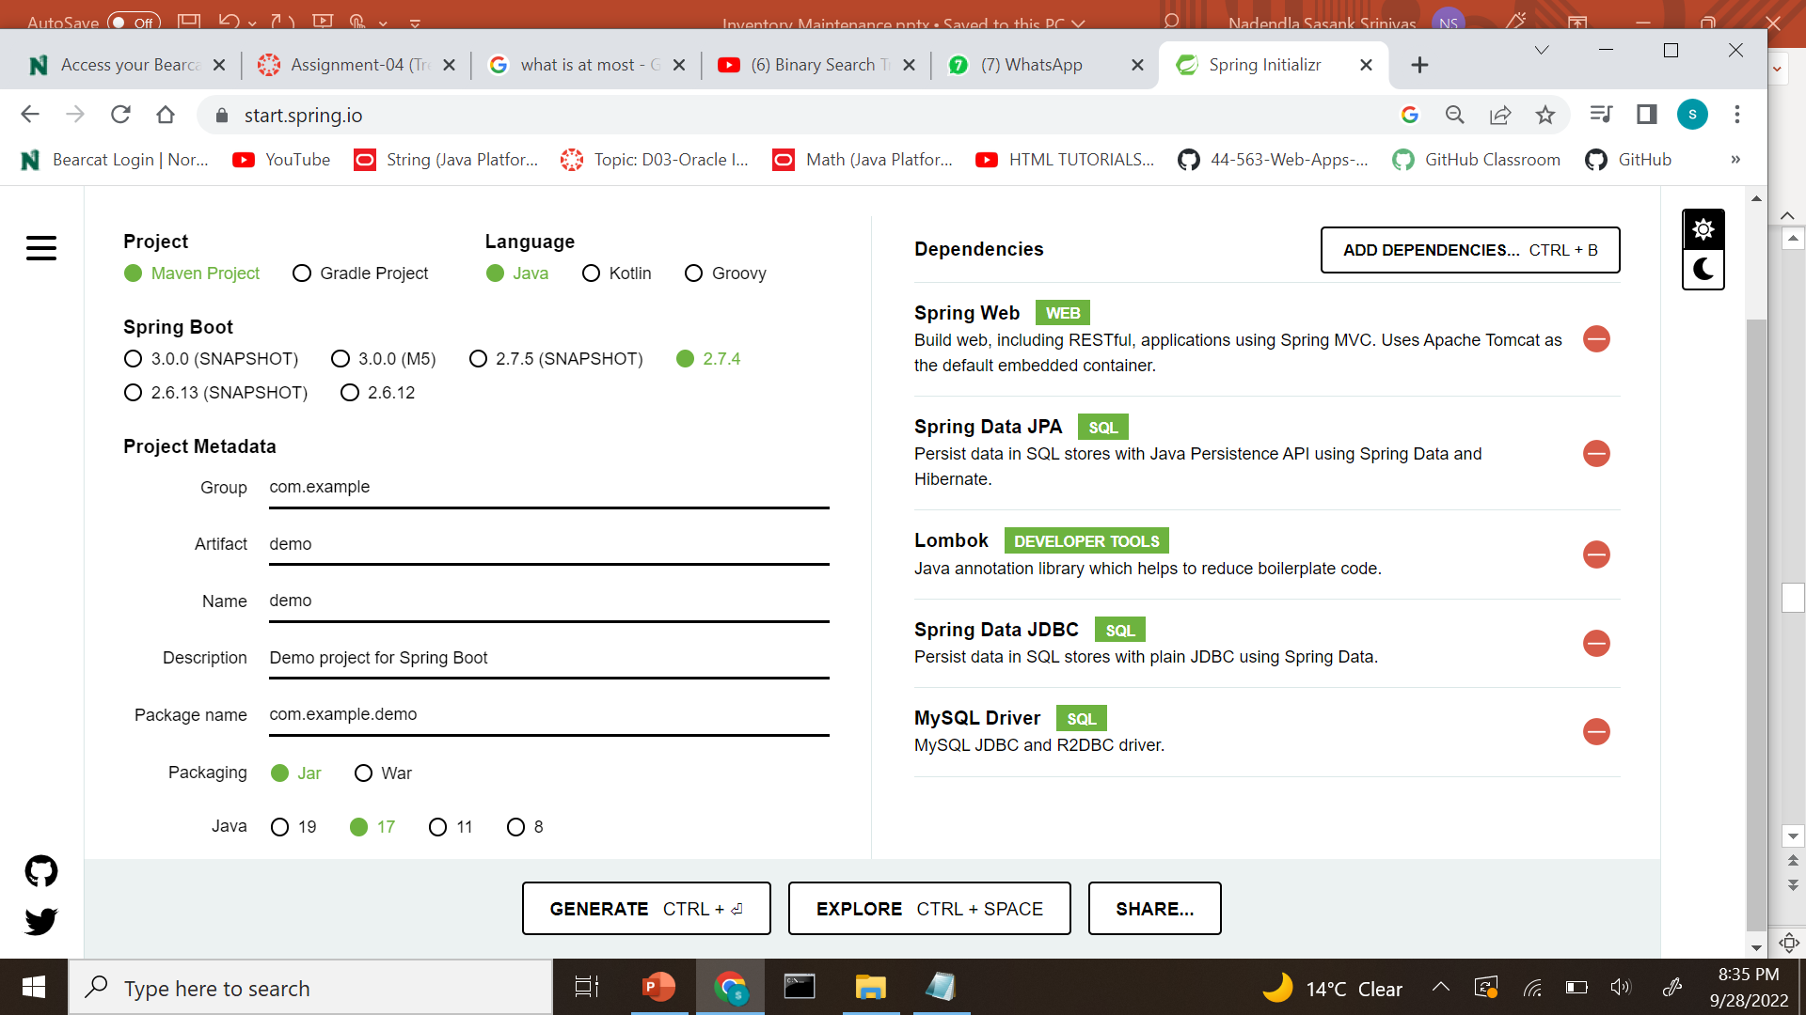
How to create Spring Boot Application?
Spring initializr allows you to create a pre-designed skeleton for the Spring Boot application.
Spring inItializr link : https://start.spring.io/
Dependencies can be added to pom.xml according to the requirement.
Versions, jar, or war packaging can be changed in the pom.xml.

Slide 13
REQUIRMENTS
Java 8 or 9
Spring Framework 5.0
Explicit build support is provided for Maven 3.2+ and Gradle 4
Eclipse IDE for Enterprise Java and Web Developer

Slide 14
What is JPA
It stands for Java Persistence API
The Java Persistence API (JPA) is a specification of Java
JPA acts as a bridge between object-oriented domain models and relational database systems
As JPA is just a specification, it doesn't perform any operation by itself.

Slide 15
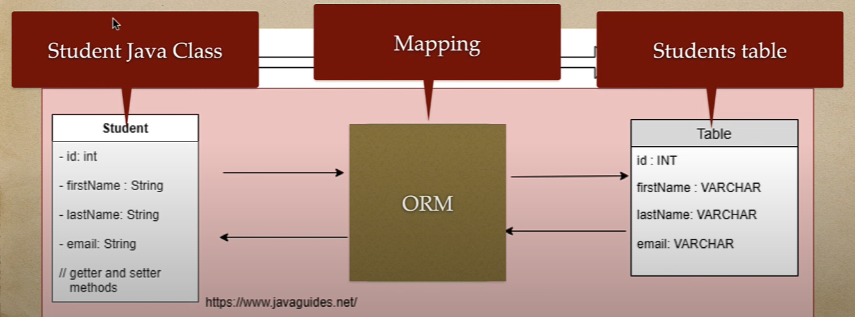
what is ORM
ORM stands for (Object-relational mapping) is the programming technique to map application domain model objects to the relational database tables.
there are different types of tools to implement ORM in java
->Hibernate
->TopLink
->iBatis

Slide 16
Hibernate
Hibernate is a Java framework that simplifies the development of Java applications to interact with the database.
It is an open-source, lightweight, ORM tool.
Hibernate implements the specifications of JPA (Java Persistence API) for data persistence.

Slide 17
why only JPA why not JDBC?
-> JPA is database independent, single query will work for all ORACLE, MySQL, SQL Server, etc. If we change the database, we need to change just the provider in a configuration file.
-> In JPA if we fetch the data from the parent table, data from the child table (which is related using a foreign/primary key) will be fetched automatically.
-> In the XML file you can see all the relations between tables in the case of JPA. Easy readability.
-> Productivity is good because we don’t need to write queries.

Slide 18
Versions
JPA 1.0 was released in 2006 as a part of the EJB 3.0 specification.
JPA 2.1 - JPA 2.1 was released in 2013.
JPA 2.2 - The JPA 2.2 was released as development of maintenance in 2017.
JPA 3.1 -This is the latest version released in spring 2022.

Slide 19
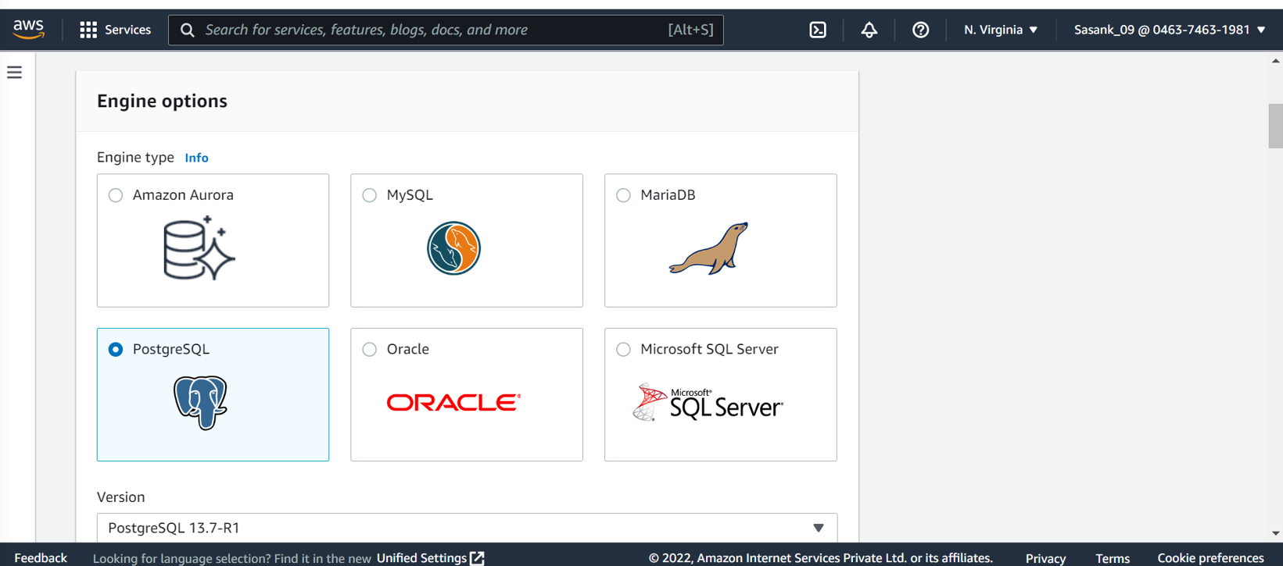
AWS
Amazon RDS is a managed relational database service that provides you with six familiar database engines to choose from, including Amazon Aurora, MySQL, MariaDB, PostgreSQL, Oracle, and Microsoft SQL Server. Amazon RDS handles database tasks, such as patching, backup, recovery, failure detection, and repair.

Slide 20
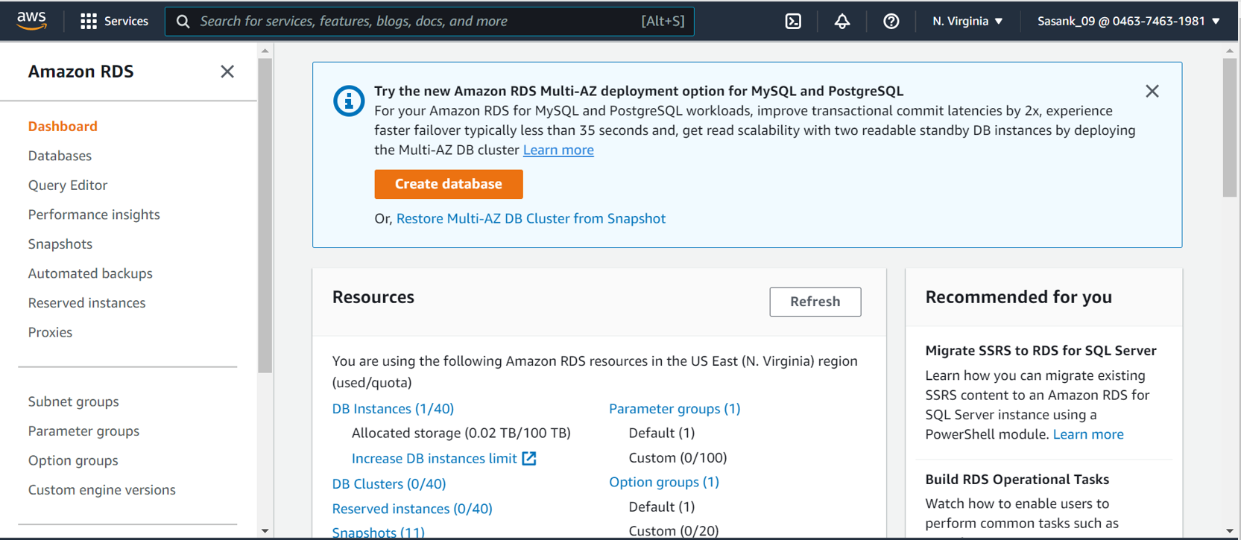
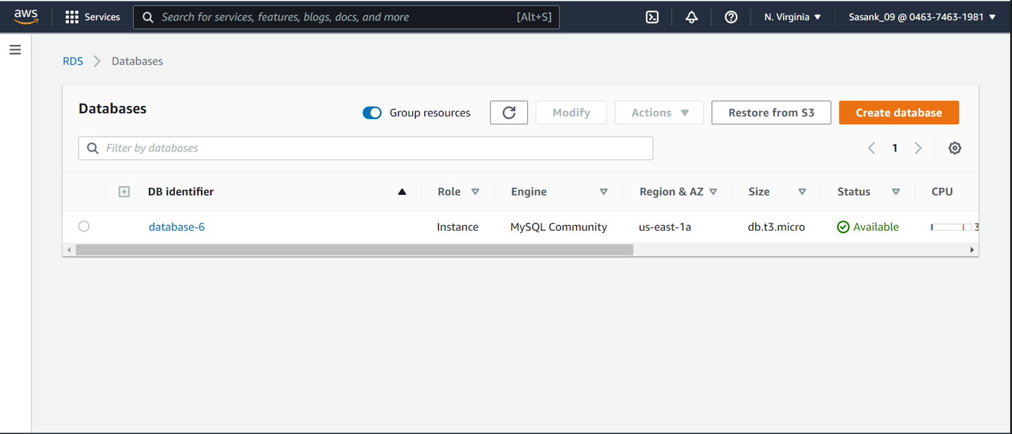
Steps to create AWS and connect to MySQL workbench

Slide 21
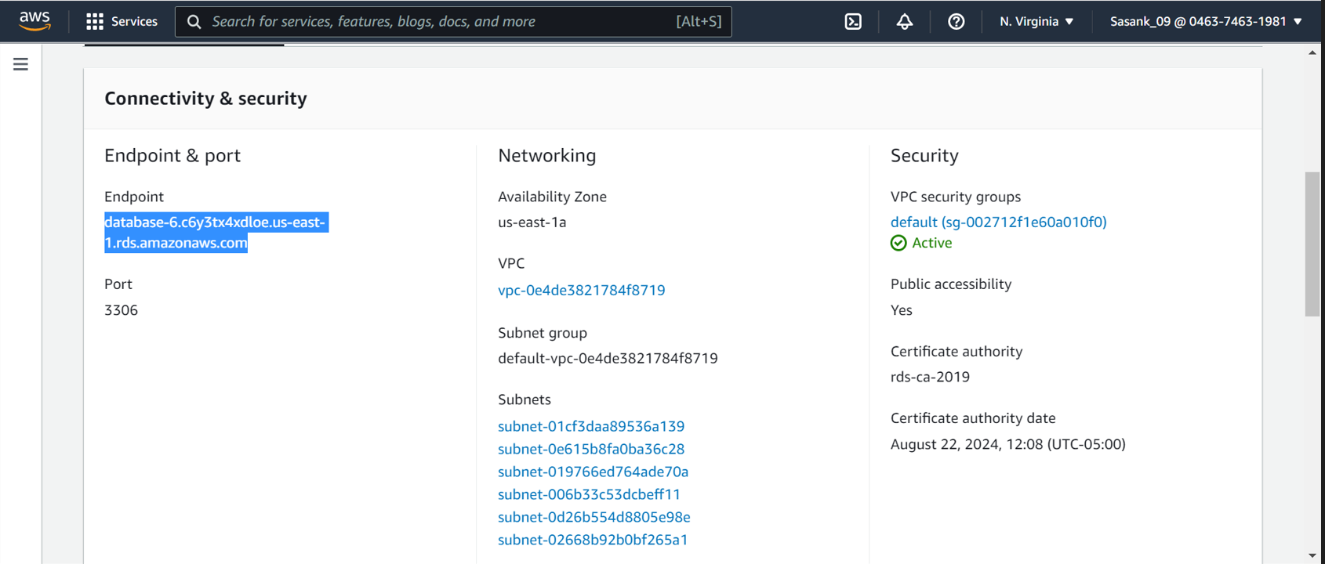
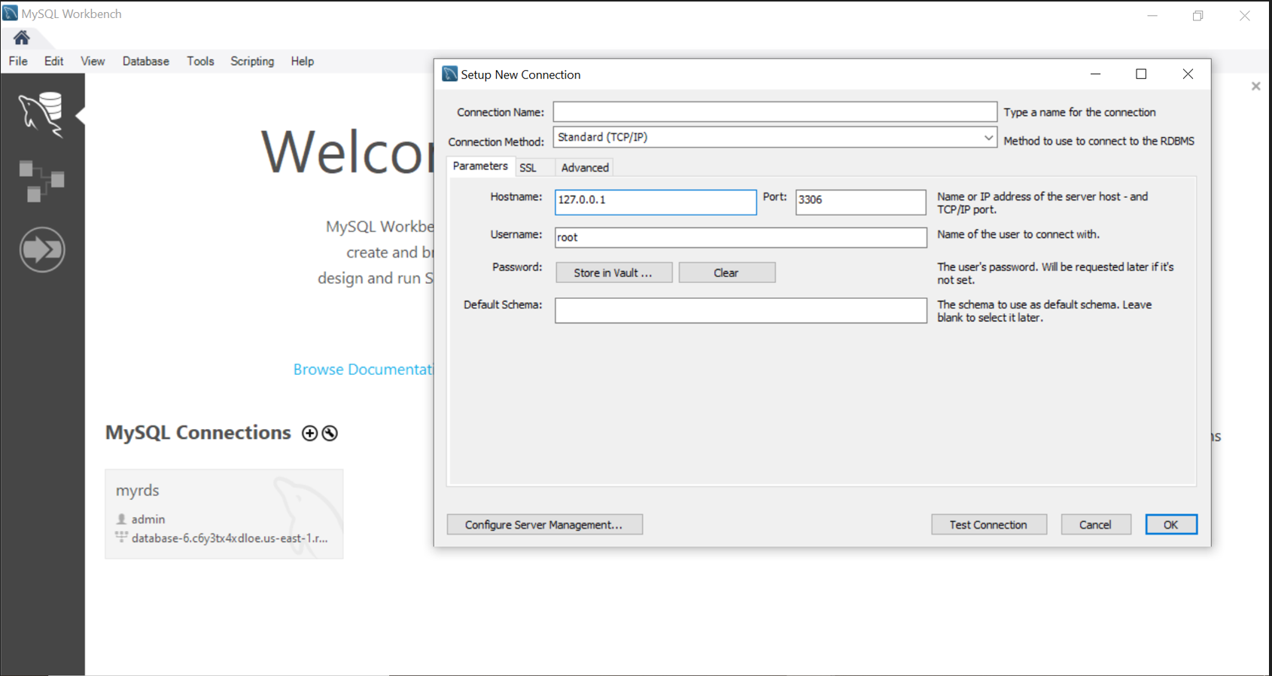

Slide 22
Lessons learnt
While passing object to UI by using postman, at first, we sent JSON data by opting raw data with text.
We faced an issue while clicking on send using post method, later we realized we need to opt for JSON format instead of text.
This is one thing we got stuck while passing the data to database.

Slide 23
Summary
We hope you got a basic understanding of react js, Spring Boot, JPA, and AWS RDS.
We believe this short presentation will be helpful to persons new to these technologies.
We are adding this ppt is our GitHub repo.
Link to the repo: https://github.com/sravani-jakkula/GDP-Project
You can visit the about link for the reference about the topics we discussed.

Slide 24
THANK YOU

